Slide 1


Team D
Final project
Notes:
Version 1

Slide 2

Team D
Zakariya Farah
Tuomas Kankaanpää
Meeri Forslund
[Picture]

Slide 3
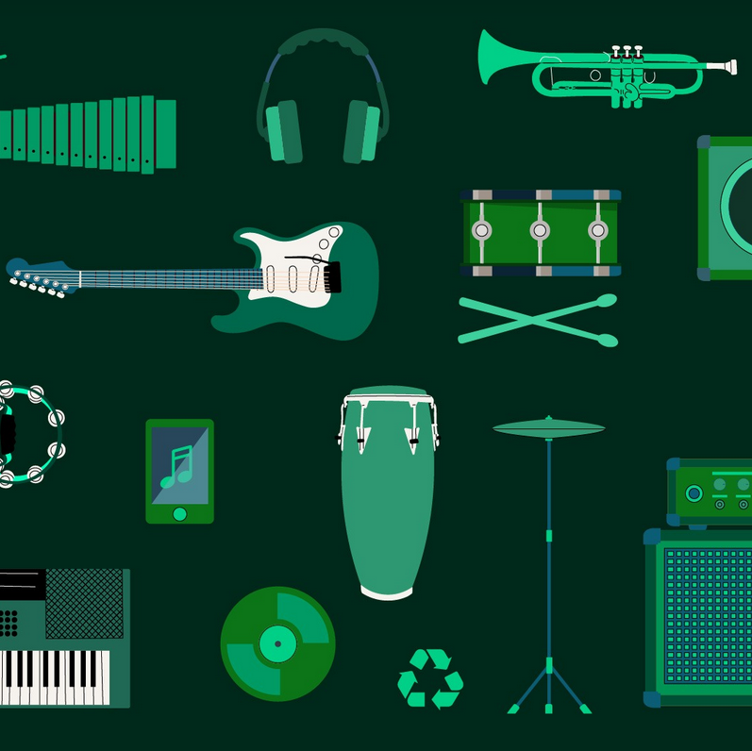
Are you also a music heavy user? Have you ever thought about the environmental impact of your music listening habits?

Slide 4
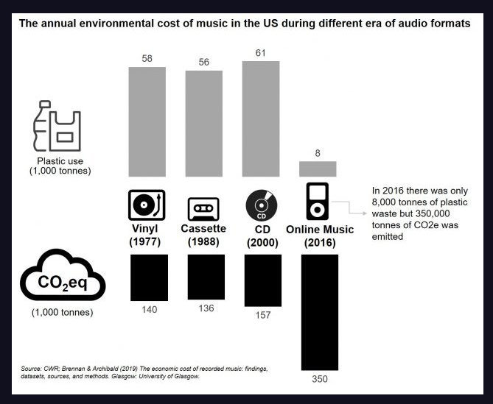
You are streaming the music so you are not creating any waste. This is green, or is it?

Slide 5
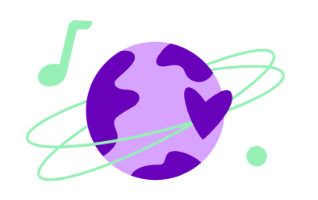
Spotify is moving from traditional data centers to the carbon-neutral Google Cloud platform, whose mission is to power its data centers with clean energy by 2030

Slide 6
What about the cultural sustainability? How is your music listening habits affecting

Slide 7

Demo
Tuomas will demonstrate our solution (Live or video)

Slide 8
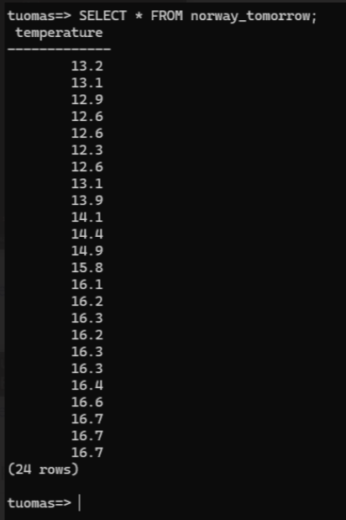
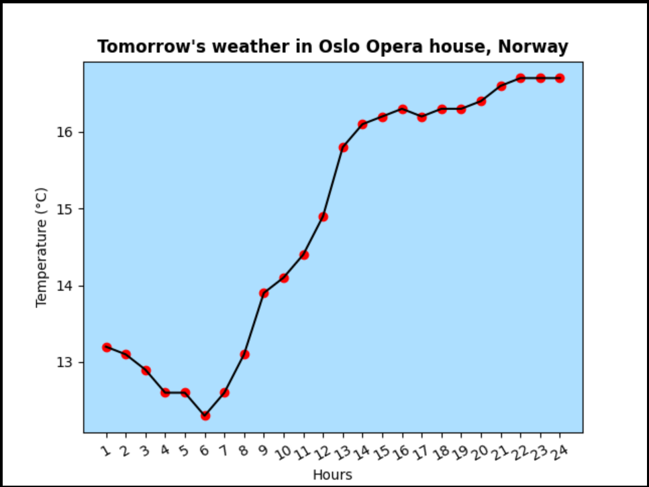
Table view and graph for Oslo Opera house’s weather

Slide 9
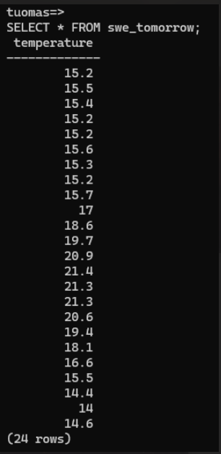
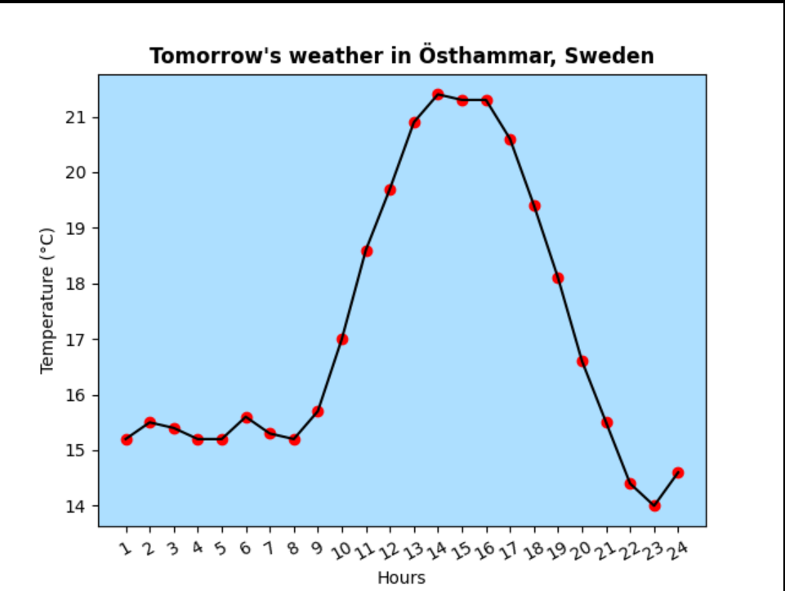
Table view and graph for Östhammar’s weather

Slide 10
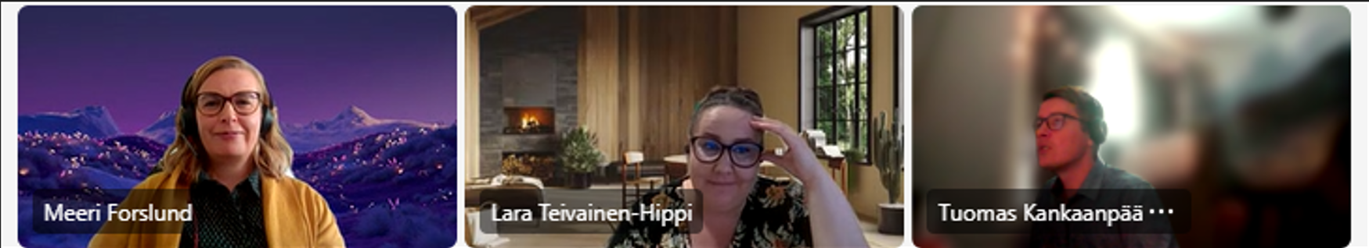
Experiences & learning outcomes
From the beginning, our team decided to work together in Teams, since the
project was hard to cut in to smaller tasks to work on individually.
Overall, our project went well, and we didn’t run into any bigger hurdles.
In the beginning of the project, we had some minor technical issues that we were able to solve ourselves.
We learned that we can do a lot more than we thought we could.

Slide 11
What we will do again in future projects?
01
02
03
04
05
We will make it easy to ask questions.
We will use GitHub to collaborate.
We will keep a saved copy of a working code.
We will work with the code in small pieces.
We will test the code freguently.

Slide 12
What we will do differently in the future?
01
02
03
05
We will plan the whole project better from start to finish.
We will divide tasks to work more individually.
[Add body text – keep it short and on point with a few lines of text]
We will focus on key tasks.

Slide 13
Q&A

Slide 14
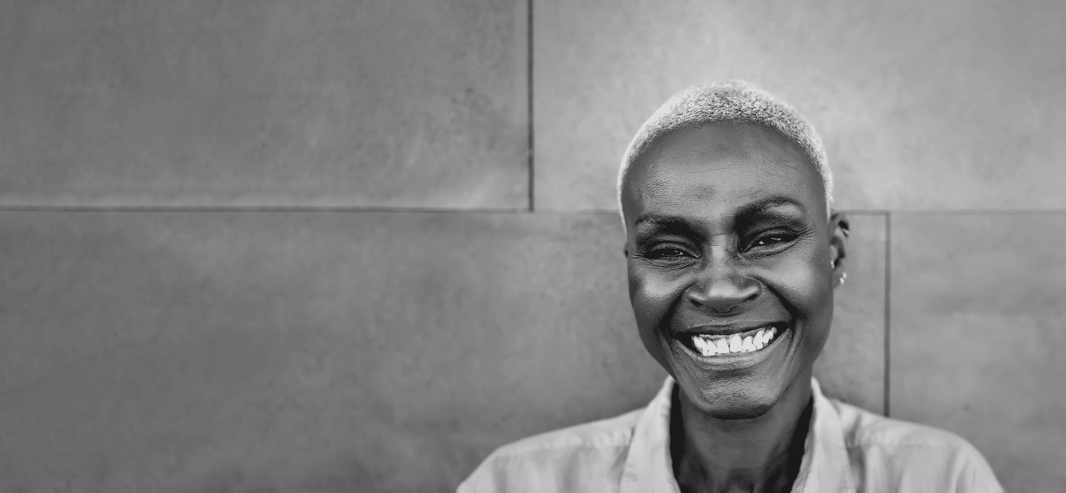
Thank you!
Notes:
Version 1

